Slide 1
Session: Connecting New Innovation to Improve Sepsis Care: The Development Story
Kimberly Sciarretta, PhD (moderator)
HHS/ASPR/BARDA
Sepsis Summit, September 9, 2020

Slide 2
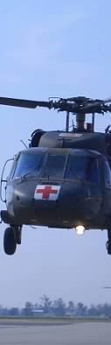
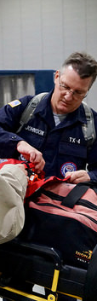
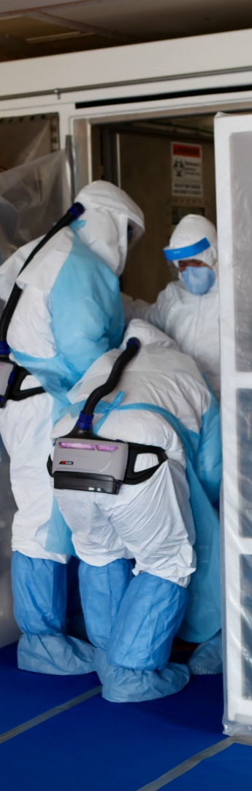
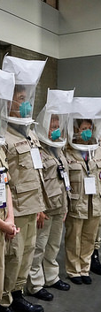

ASPR Mission
Save Lives and Protect Americans from 21st Century Health Security Threats
Notes:
Simply put, the mission of the Assistant Secretary for Preparedness and Response is to “Save Lives and Protect Americans from 21st Century Health Security Threats”.

Slide 3


The BARDA Model
Flexible, nimble authorities
BARDA develops and makes available medical countermeasures (MCMs) by forming unique public-private partnerships to drive innovation off the bench to the patient to save lives.
Promote innovation
Multi-year funding
Facilitate partnerships
Cutting edge expertise

Slide 4




BARDA Program Divisions
Medical Countermeasures (MCM) Program
Influenza & Emerging Infectious Diseases
Chemical, biological, radiological and nuclear (CBRN) Program
Detection, Diagnostics, & Device Infrastructure
Pharmaceutical Countermeasure Infrastructure
Division of Research, Innovation, and Ventures (DRIVe)

Slide 5
DISCLOSURES
The views expressed are solely those of the authors and do not necessarily represent those of the U.S. Department of Health and Human Services.
Panel members were selected solely by The Sepsis Alliance and do not represent any relationship with BARDA, as moderator of this session.

Slide 6
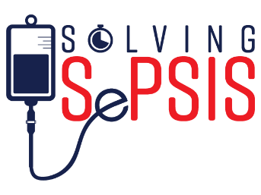

Challenges in Current Practices
Lack of patient education/awareness
Lack of accurate biomarkers
Standard of care practices inadequate
Sepsis not considered by physician
Misdiagnosis
Lack of understanding of immune dysregulation
Infection
Diagnosis
Intensive Care
Inability to restore homeostasis
Delayed pathogen detection & treatment (incorrect antibiotic, AMR, etc.)
Delayed access to healthcare
Patient comorbidities
Patient population heterogeneity (age, background, pathogen)
Death from sepsis may occur rapidly despite medical care

Slide 7
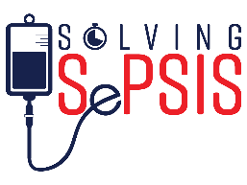
Sepsis Patient Continuum
Each Red Node is an Opportunity to Intervene
SURVIVALResilience
HOSPITAL ACQUIRED
(<20%)
PREVENTION
RELEASE
Post-sepsis
Syndrome
T=0
Sepsis Phenotype
Detectable
Physical Signs
ORGAN DYSFUNCTION
SHOCK
ONSET
INFECTION
RE-ADMISSION
COMMUNITY ACQUIRED
(>80%)
MORTALITY

Slide 8
Product Development- Considerations
HealthCare Provider/User Needs
Patient Perspective
Clinical Settings
Clinical Evidence to Support Utility
Improving /Changing Patient Care
Regulatory Path
Adoption/Implementation Incentives for Use

Slide 9
Moderator Questions
What is your vision towards changing care for sepsis patients?
How are you taking an innovative approach?
How have you addressed the user needs (Patient or HealthCare provider) in product development?
Who is the advocate for your technology?
How has clinical engagement (clinical studies, HCP feedback) changed your development path?
What do your foresee as the biggest challenge in integrating your technology into clinical practice?
What hurdles have you successfully been able to tackle?
What are some of the future unknowns in product development?
What advice do you have for sepsis product developers?

Slide 10











How to Contact BARDA
medicalcountermeasures.gov Portal to BARDA: Register to request a TechWatch meeting!
beta.sam.gov/ Official announcements and info for all government contract solicitations
phe.gov/BARDA Program description, information, news, announcements
drive.hhs.gov Learn about DRIVe, including our Accelerator Network and EZ BAA
www.usajobs.gov Join the team!

